Slide 1
Adaptive Policy-making, ADAPTool applications and measuring policy contributions to adaptation
Dimple Roy and Livia Bizikova (IISD)

Slide 2
Presentation Outline
Adaptive Policy-making: A brief overview
ADAPTool: what is it, what does it do?
Recent ADAPtool applications
Measures of policy contributions to adaptation needs
Measures of policy adaptiveness

Slide 3
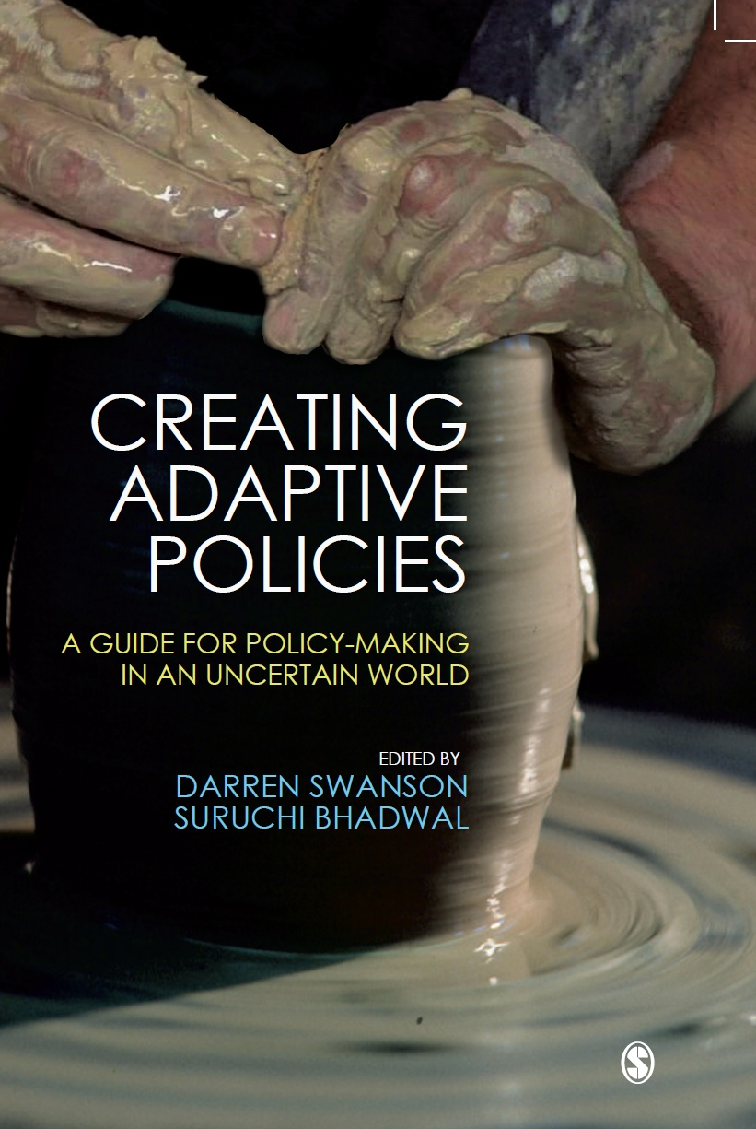
Adaptive Policy-making: An Introduction
Policies that cannot perform effectively under complex, dynamic and uncertain conditions run the risk of not achieving their intended purpose, and becoming a hindrance to the ability of individuals, communities and businesses to cope with—and adapt to—change.

Slide 4
Elements of Adaptive Policies
Integrated and forward-looking analysis
Built-in policy adjustment
Formal policy review
Multi-stakeholder deliberation
Promoting variation
Enabling self-organization
Decentralization of decision-making
Adaptive Policy
Planned Adaptability (for anticipating)
Ability of policy to
adapt to anticipated
conditions
Ability of policy to
adapt to unanticipated
conditions
Autonomous Adaptability
(for unanticipated issues)
(based on a good understanding of cause and effect)
(based on a good understanding of system dynamics and complexity)

Slide 5
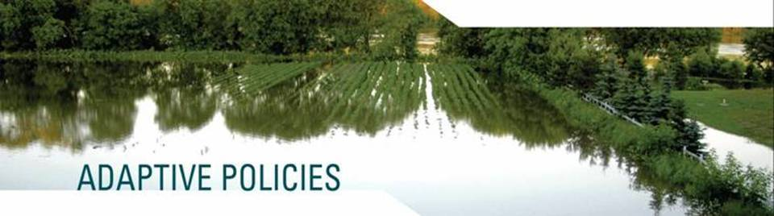
The ADAPTool
(Adaptive Design and Assessment Policy Tool)
Are the policies supporting anticipated adaptation needs?
Are the policies adaptive themselves?

Slide 6
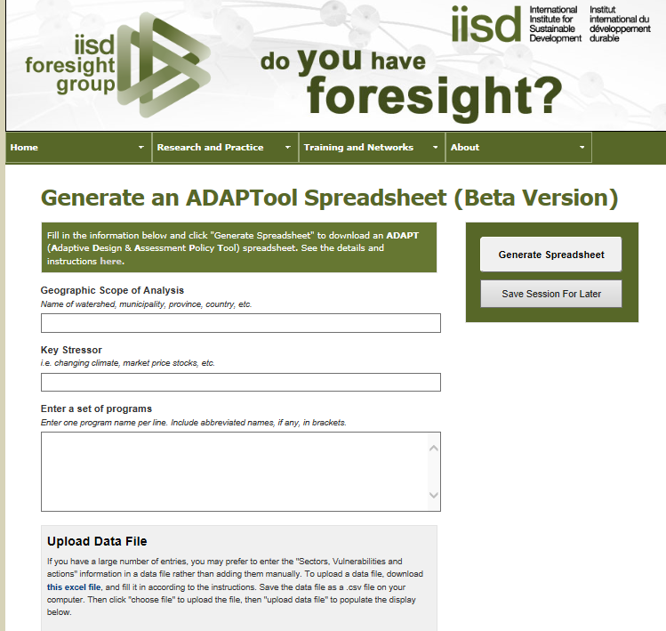
http://www.iisd.org/foresightgroup/adapt.aspx

Slide 7
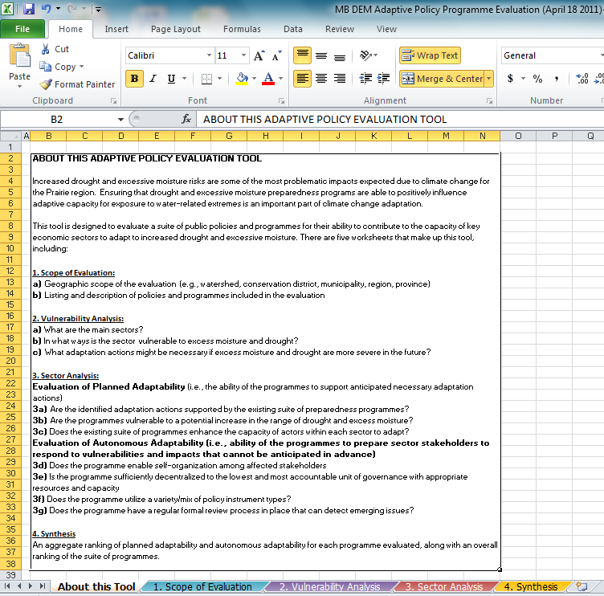
The ADAPTool
(Adaptive Design and Assessment Policy Tool)
Four Worksheets
Scope
Sector Vulnerability and Adaptation Analysis
Policy Adaptive Capacity Analysis
Policy Synthesis
MS Excel Workbook

Slide 8
ADAPTool Analysis Questions
Planned Adaptability
(Ability of policy to support anticipated adaptation actions)
Are anticipated adaptation actions supported by the policy?
Is the policy itself vulnerable to the stressor?
Can the policy enhance the capacity of actors to undertake adaptation actions?
Was multi-stakeholder deliberation used in the policy design?
Autonomous Adaptability
(Ability of policy to enable sector stakeholders to respond to unanticipated issues)
Is multi-stakeholder deliberation used in implementation?
Does the policy enable self-organization and social networking?
Is decision-making adequately decentralized?
Is there adequate variety in the suite of policies?
Does the policy have a regular formal policy review?

Slide 9
ADAPTool Analysis Questions for new policies
Evaluation of Planned Adaptability (i.e., the ability of the programmes to support anticipated necessary adaptation actions)
What is the policy goal and objectives
In what way are relevant sectors vulnerable to climate change?
What adaptation actions might be necessary if this stressor becomes more severe in the future?
Could the policy objective potentially support this adaptation action?
How can the policy be designed to be resilient to the stressors?
How could the policy potentially enhance the capacity of relevant stakeholders to adapt to drought/excess moisture?

Slide 10
Multi-province analysis: An Overview
Four-province analysis using ADAPtool in British Columbia, Saskatchewan, Manitoba, and Nova Scotia
British Columbia: Agriculture, fisheries
Saskatchewan: 25-year Water Security Plan
Manitoba: Forestry, new wetland policy
Nova Scotia: Protected Areas, water and wastewater management
Two-province analysis using ADAPtool for mining policies
Saskatchewan: Mining policies
Manitoba: Mining policies

Slide 11
Provincial analysis: Process
 | Capacity-building about the use of the ADAPTool | Identifying vulnerabilities and adaptation needs for the ADAPTool | Policy assessments using the ADAPTool | Final report development
Nova Scotia | Workshop with department policy-makers | Workshops to identify options and review | Provincial policy-makers with support from IISD | IISD and reviewed by the provincial leads
British Columbia | Training workshops for provincial program staff | Climate Risk and Opportunity Assessments conducted previously | Ministry staff and IISD, results reviewed by program staff | Ministry staff with IISD input
Manitoba | Workshop with department policy analysts | Meetings and email reviews with key stakeholders | IISD and Provincial analysts and reviewed by analysts from both agencies | IISD and reviewed by provincial leads.
Saskatchewan | Training to Saskatchewan project lead | Teleconferences and email reviews with key stakeholders | Conducted by IISD researchers | Developed by IISD analysts.

Slide 12
Illustrative results: BC Agriculture Policies
Key: AgriStability (AS); Production Insurance (PI); Regional Agrologist Network (RAN); Strengthening Farming SF); Agroforestry (AF); Range Management (RM); Invasive Plants (IP);
Pest Management (PM); Environmental Farm Plan (EFP); Beneficial Management Practices (BMP); Ag. Emergency Management (AEM); Agriculture Water Management (AWM); Water Act Modernization (WAM); Agri-FoodBusiness Development (ABD)

Slide 13
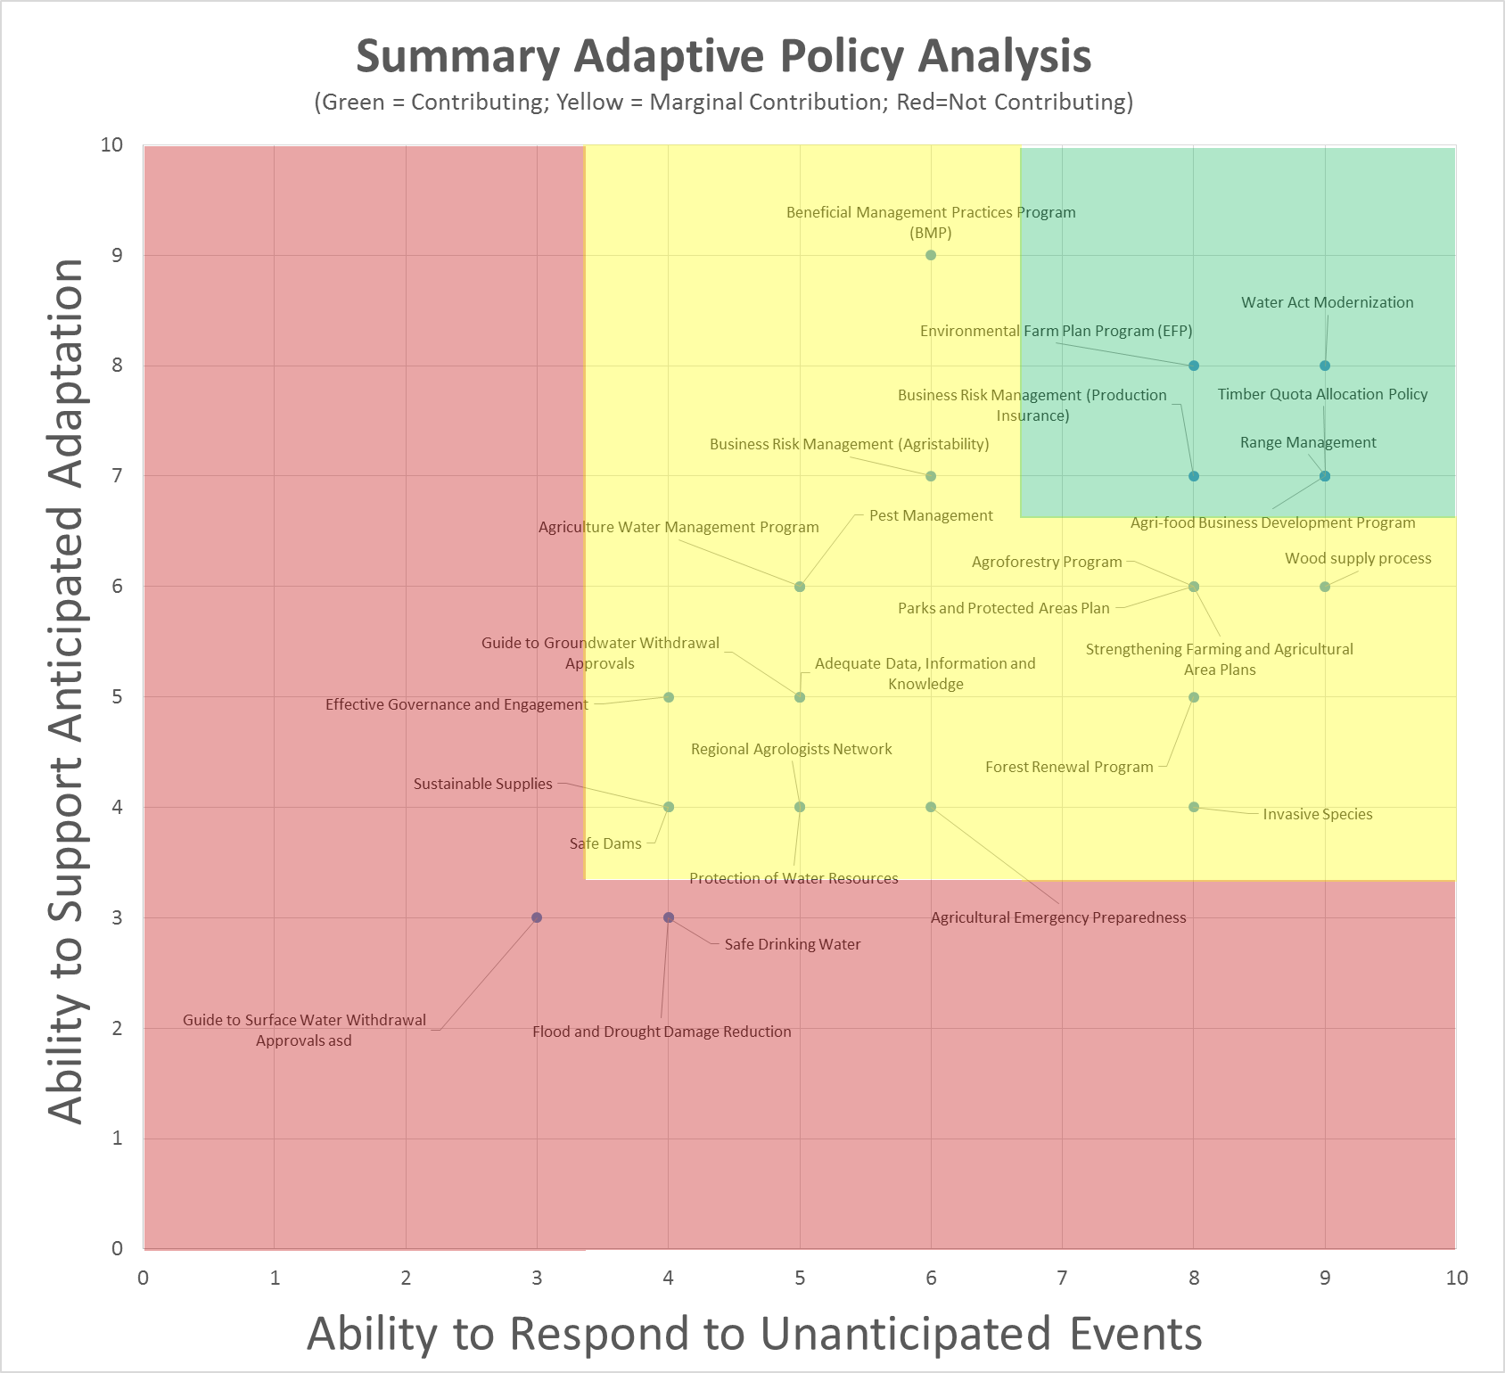

Slide 14

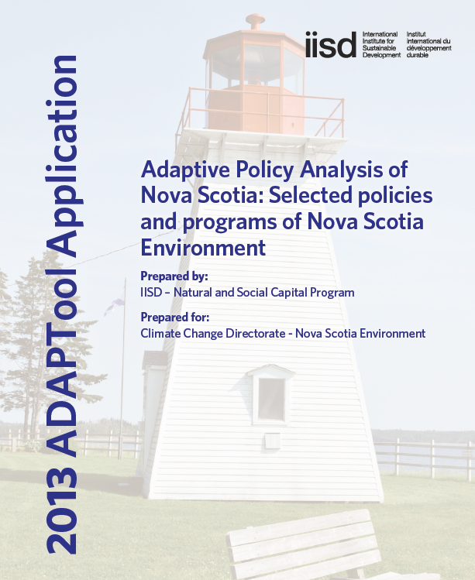
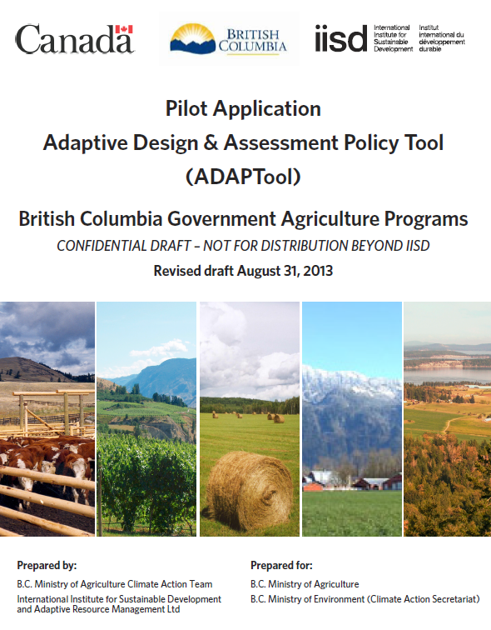
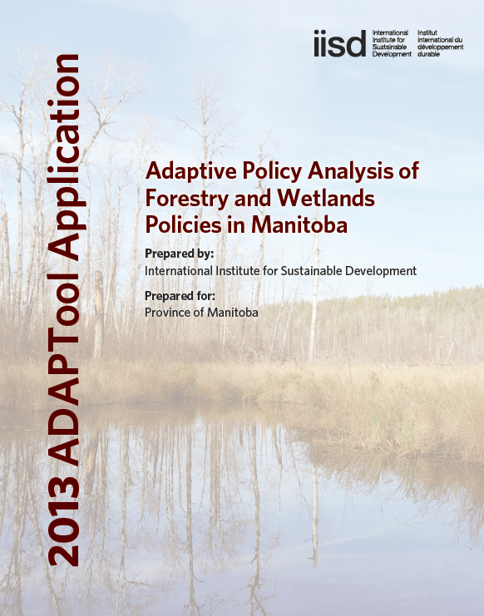
Provincial Reports

Slide 15

Monitoring indicators based on outcomes of policy assessments using ADAPTool

Slide 16

Climate Resilience and Food Security in Central America (CREFSCA)
Key goals of the project:
Communities understand their own sources of resilience better, can take action to strengthen in collaboration with gov and non-gov agencies, and monitor progress over time
Policy makers and development practitioners have a better understanding of the sources of climate resilience in national food systems and how their policies can affect it. This will lead to better policies on food and nutrition, DRR and CC
The scientific understanding of the links between climate hazards and food security and on resilience drivers at different levels will be improved
Three countries: Nicaragua, Honduras and Guatemala
Supported by CDKN

Slide 17
FIPAT tool
The Food Security Indicator & Policy Analysis Tool (FIPAT)
The tool is based on IISD’s ADAPTool which provides an assessment process that compares existing policies and programs to the characteristics of adaptive policies set out through previous research.
FIPAT guides users in a structured way to evaluate a suite of public policies on their ability to contribute toward the adaptable food systems and key actors within such systems.
FIPAT produces specific indicators that help monitor the resilience of food systems along with recommendations for improving the resilience impact of key policies.

Slide 18
Sources of indicators
Each level of the ADAPTool policy assessment provides different types of indicators
These indicators can be used to monitor progress towards adaptation
Indicators need to be prioritized as they can lead to large number of indicators that is challenging to actually monitor

Slide 19
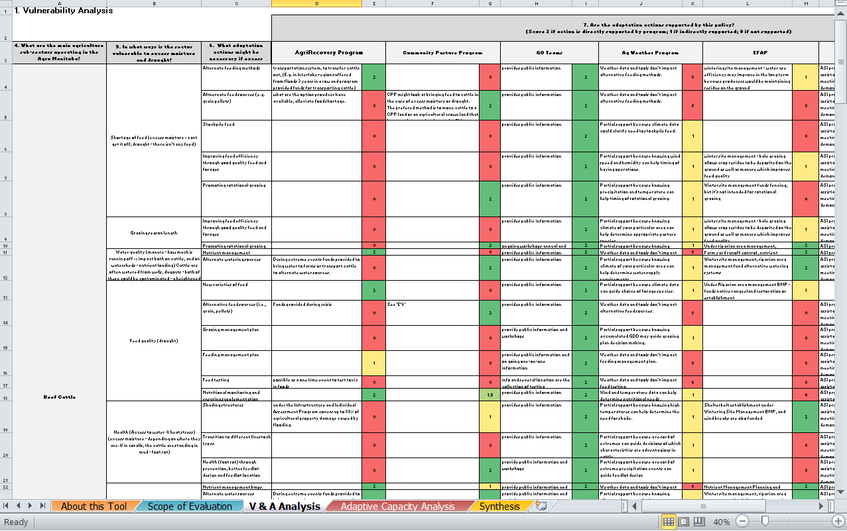
2. Vulnerability and Adaptation Analysis
Measuring the support for anticipated adaptation actions

Slide 20
Indicators measuring support for adaptations
  No. of projects, their duration and participation for vulnerable communities on land use management that promote best practices on soil conservation, irrigation and the use of agro-forest systems
  No. of projects in water management in drought prone areas and number of water conservation projects implemented in community with high-level of food in security
  % of budget invested by community for maintenance of access roads (is this allocation of funds from the gov’t?); frequency of maintenance works to infrastructure especially in vulnerable areas
  No of farmers linked to cooperative storage centre and their participate over multiple years
  No of infrastructure mitigation (landslides) projects completed;
  No of rural branches that offer savings and credit services for small-farmers and producers

Slide 21
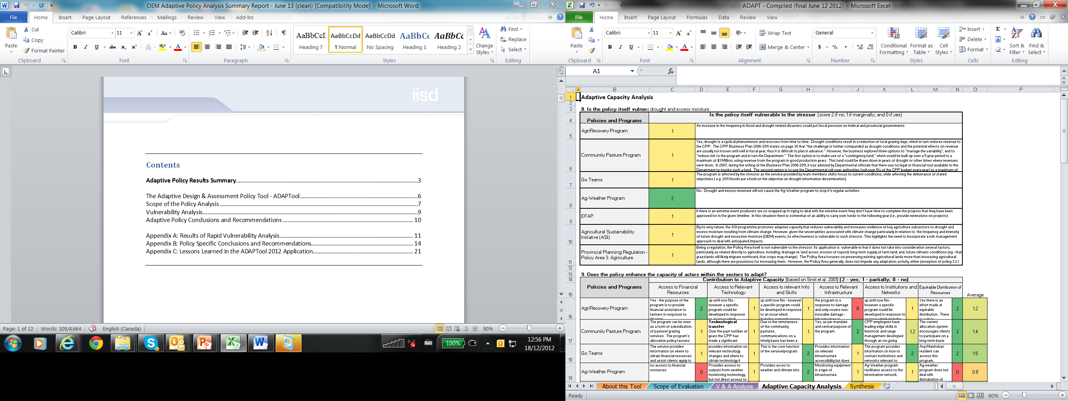
3. Policy Adaptive Capacity Analysis
Measuring the support of policies for specific aspects of adaptive capacities

Slide 22
Indicators measuring capacities
Monitoring up-take of best practices and capacity-building relevant for food security:
  No of producers using organic agricultural inputs over at least 3 years or more
  No. of producers that use best practices in soil conservation; ecological pest management
  % of farmers using forecasting systems and other information on seasonal changes and variability
  No of capacity building sessions with follow-up received by community organization;

Slide 23
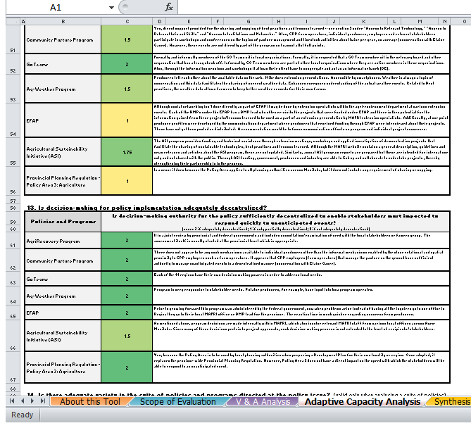
Monitoring abilities of policies to respond to challenges
Measuring types of participation in decision-making, policy reviews, levels of decentralization

Slide 24
Indicators measuring efforts on decision-making processes
  No of committees in the community engaged in response and prevention
  Adopted and regularly reviewed municipal post-disaster relief plans and no of those that have financial resources available for their implementation
  No of sessions/ meetings in the community and with other policy-makers to identify and document lessons learnt from emergency situations
  No of consultations and specific inclusions of local and vulnerable communities in emergency preparedness review
  No. of staff and available financial resources invested for prevention and emergency response per year; amount of financial resources available budget for climate risk management;
  Number of consultation with national and regional agencies on vulnerability reduction, improving food security in the context climate change
  Ability of the local government to act autonomously during emergencies and take a lead to coordinate relief
  Involvement of vulnerable community representatives in resource allocation during emergencies ate the municipal level It is only mentioned once in Puerto Morazan, Nicaragua

Slide 25
Conclusions
Monitoring specific aspects of policies/programs key part of ensuring food security
Monitoring levels of participation policies (high level of awareness of communities on the role of participation/processes in decision-making and thus a need for measuring)
Compiled set of indicators based on already undergoing monitoring efforts
Indicator can be used to feed into adaptation planning

Slide 26
For more information:
Dimple Roy
droy@iisd.ca
Livia Bizikova
lbizikova@iisd.ca

