Slide 1
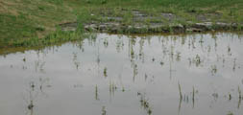
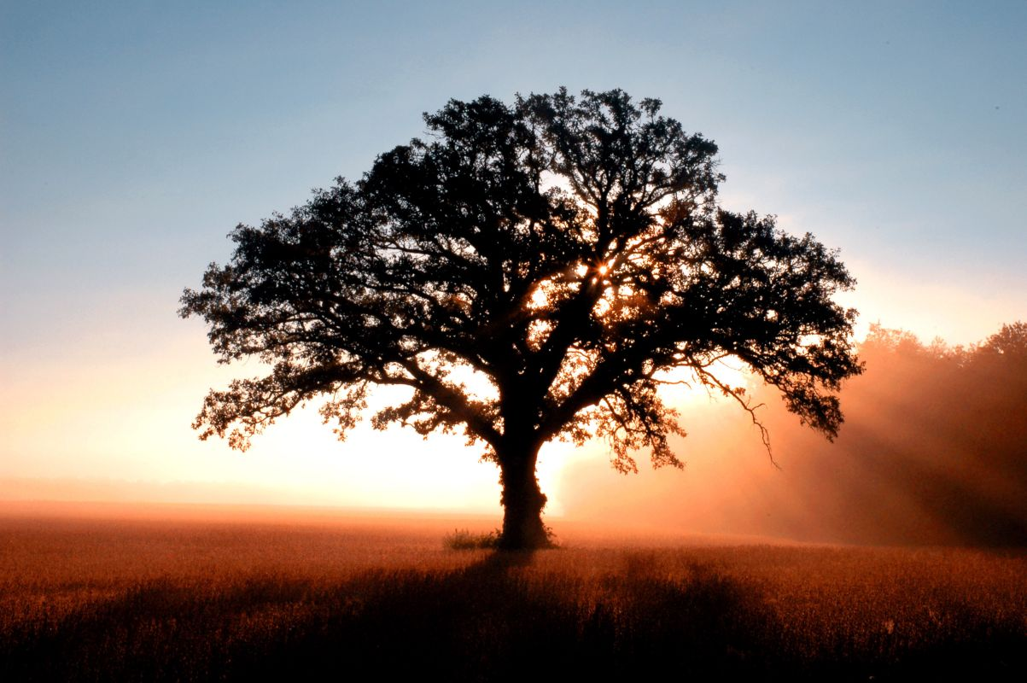
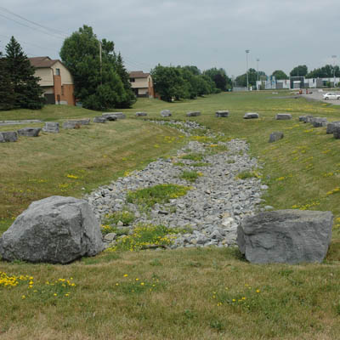
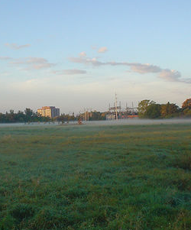

x
Photos from flickr.com,
creative commons
2nd National Canadian Sustainability Indicators Network Conference
Walking the Talk: Sustainability Assessments and Real Change
March 2nd - 3rd, 2010
Notes:
1

Slide 2
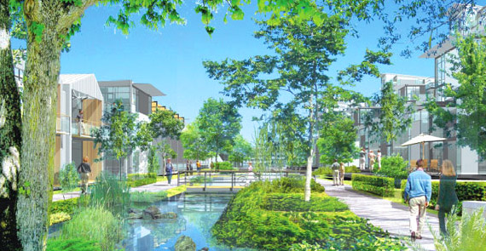
Sustainability: what it is...
sustainable development is a process of reconciliation of three imperatives—the ecological imperative to live within global biophysical carrying capacity and to maintain biodiversity; the social imperative to ensure the development of democratic systems of governance that can effectively propagate and sustain the values by which people wish to live, and the economic imperative to ensure that basic needs are met worldwide. And equitable access to these resources—ecological, social, and economic—is fundamental to its implementation (Dale 2001; Robinson and Tinker 1997).
Dockside Green, Victoria, BC
Notes:
2
This definition is the latest theoretical concept of sustainability, addressing some of the critical ambiguities represented by the Bruntland definition. But how do you manifest this? One of the best, yet not perfect examples, is Dockside Green in Victoria BC. Lindsay, was on the team that conceived the triple bottom line approach of Dockside Green is. We have also worked as high level sustainable building consultatnts, developed sustainable living guides for residents and tenants. Dockside Green is a LEED Platinum development.

Slide 3
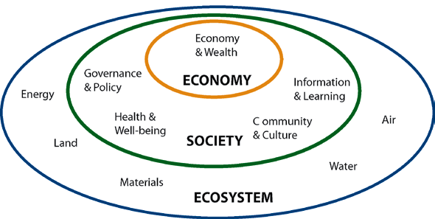
Sustainability: what it is...
Where ecological, social and economic meet:
  Adopting a long-term perspective
  Meeting human needs
  Redefining prosperity
  Participatory governance systems
  Sharing natural resources equitably
  Protecting the global ecosystem
  Building the relationship between
  people and place
Sustainability is a PROCESS.
Notes:
3
This definition is the latest theoretical concept of sustainability, addressing some of the critical ambiguities represented by the Bruntland definition. But how do you manifest this? One of the best, yet not perfect examples, is Dockside Green in Victoria BC. Lindsay, was on the team that conceived the triple bottom line approach of Dockside Green is. We have also worked as high level sustainable building consultatnts, developed sustainable living guides for residents and tenants. Dockside Green is a LEED Platinum development.

Slide 4
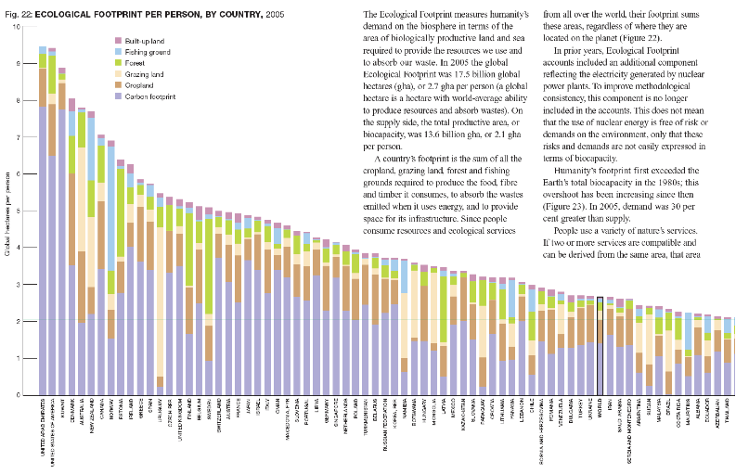

Slide 5
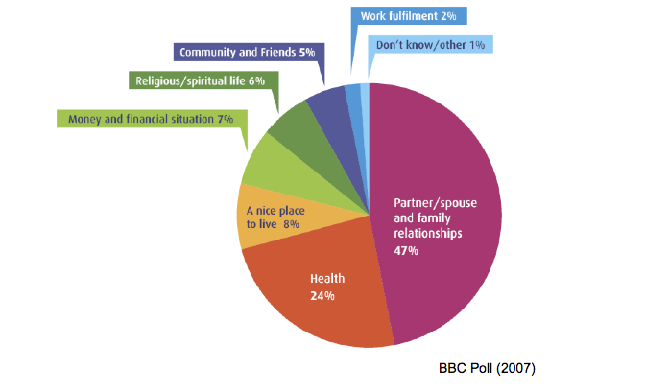
Notes:
5
This definition is the latest theoretical concept of sustainability, addressing some of the critical ambiguities represented by the Bruntland definition. But how do you manifest this? One of the best, yet not perfect examples, is Dockside Green in Victoria BC. Lindsay, was on the team that conceived the triple bottom line approach of Dockside Green is. We have also worked as high level sustainable building consultatnts, developed sustainable living guides for residents and tenants. Dockside Green is a LEED Platinum development.

Slide 6
Approach: sustainability assessments
A portrait of current social, economic and environmental performance.
For example:
Water and energy consumption
Waste production
Community (engagement, education)
Participation in the local economy
BENEFITS
Establish a baseline against which future assessments can be measured
Identify environmental and social impacts
Identify strategic opportunities
Outline recommendations and next steps to improve performance
Provide deeper accountability and transparency to stakeholders
Develop better information collection, tracking, management and
analysis systems
Notes:
6

Slide 7
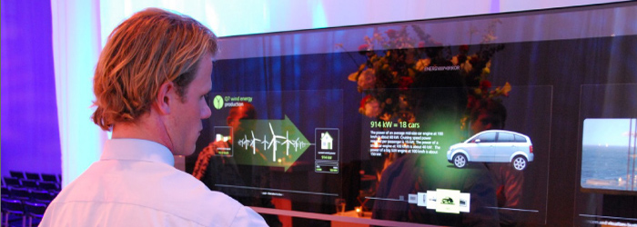
Opportunities: education, NGOs, business, healthcare
Notes:
7
we need to ask the question in every profession- what are your opportunitis to further sustainability?
Nurse who understands the impacts of VOCs from paint
Carpenters and cabinetmakers who understand ecological forestry
Cooks that use local, organic and fair trade ingredients
Early childhood educators that understand environmental education
Office administrators who set up computers to turn off automatically and reduce paper consumption
Education happens not only in the classroom but also via the physical building and the way in which the organisation is run.... the hidden curriculum.

Slide 8
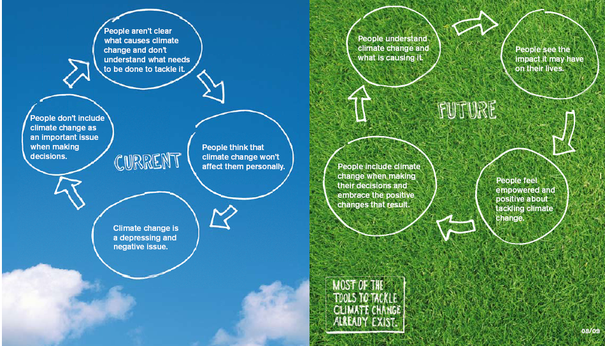
Opportunities: communications
Notes:
8
Critical to this process is the tone and messaging.
we take considerable care in the way in which we frame our messsaging- for Algonquin College will began the process with focus groups to identify messagintgthat is appropriate and resonates throughout the process.

Slide 9
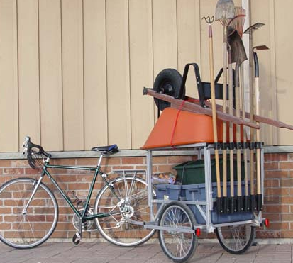
Sustainability: education
Students of all ages will need the kind of education and skills appropriate to building a society with fewer cars but more bicycles and trains; fewer large power plants but more windmills and solar collectors; fewer supermarkets and more farmers' markets; fewer large corporations and more small businesses; less time for leisure but more good work to do; and less public funding but more public spirit.
David Orr, Four Challenges of Sustainability
Bicycle-powered landscaping, Halifax, NS
Notes:
9
What does the theory of sustainability mean to education? This is a question that universities and colleges around the world are formulating as we speak. The key thinker is David Orr, author of Earth in Mind and Director of Environmental Education at Oberlin College in the US>

Slide 10
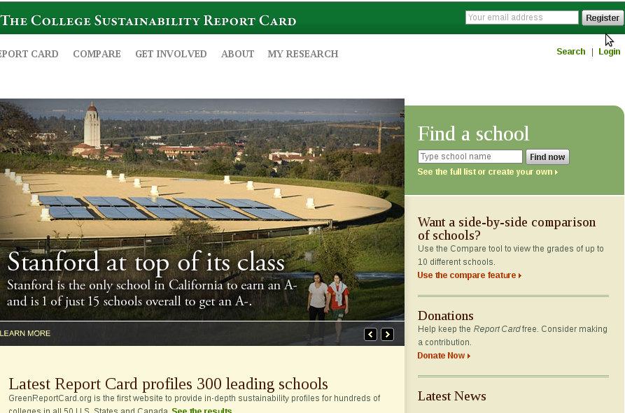
Approach: framework
  GRI
  CSAF
  STARS
  Accountability
Notes:
10
GRI (Materiality, stakeholder inclusiveness, sustainability content, completeness)
Internationally recognized protocol
Developed as a consensus standard with stakeholders
Indicators can be customized
Designed for corporations
CSAF
Designed specifically for colleges and universities
Currently common standard for being used by Canadian institutions
Balanced approach to environmental and socio-economic measures
Founded in building a multistakeholder process around assessment work
Ensures the assessment is part of a larger management system
STARS
Targeted at US Universities
Designed specifically for campuses using a multi-stakeholder process
Unequal weighting to different indicators
Balanced on sustainability issues
AccountAbility assurance standards
Meant to be used as a framework for auditing a sustainability assessment
Gives credibility and uses an internationally recognized standard for the reporting process
Could be used in conjunction with any of the others above

Slide 11
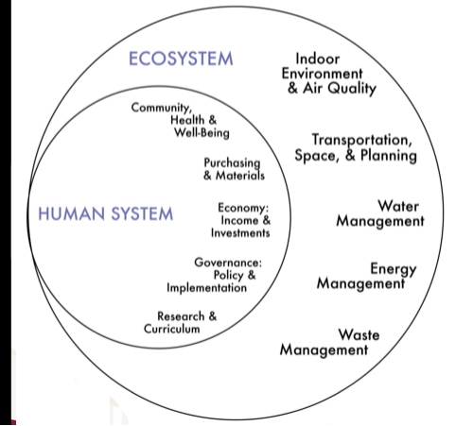
Approach: contribute to the commons
10 chapitres
33 subsections
171 indicateurs
Used by over 30 campuses across North America
Notes:
One of the team members used an innovative participatory action research process to develop sustainability indicator framework for higher education in Canada. The process involved a research team consisting of practionniers, researchers, students, faculty and administration. The resulting framework is freely available, for whoever wants to use it. It was adopted by SYC's sustainable campuses project and used by more then 40 campuses across Canada. To support these efforts, SSG prepared a guidebook to support its use. Version 2.0 was recently completed as a masters thesis by a student in Montreal. Whever possible, SSG liscences its work using the creative commons liscence as opposed to traditional copyright.

Slide 12
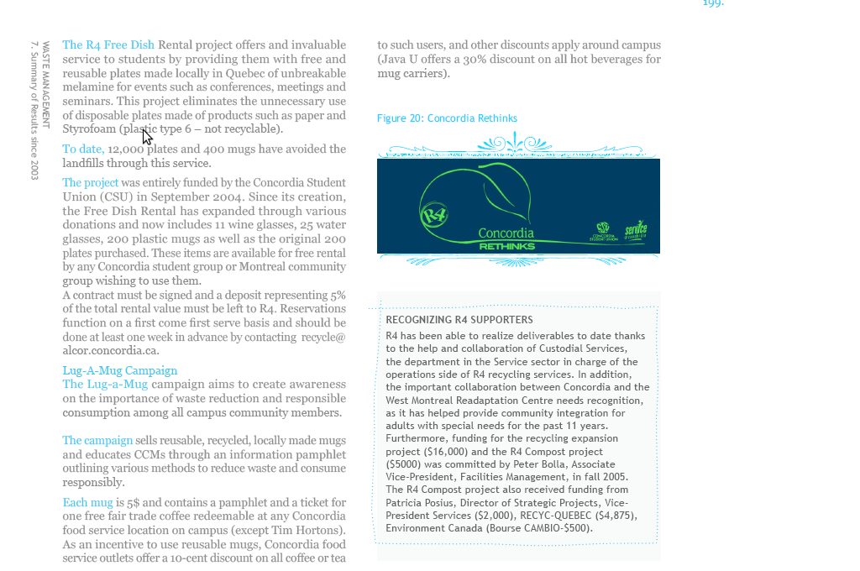
Approach: assessment
Notes:
12

Slide 13
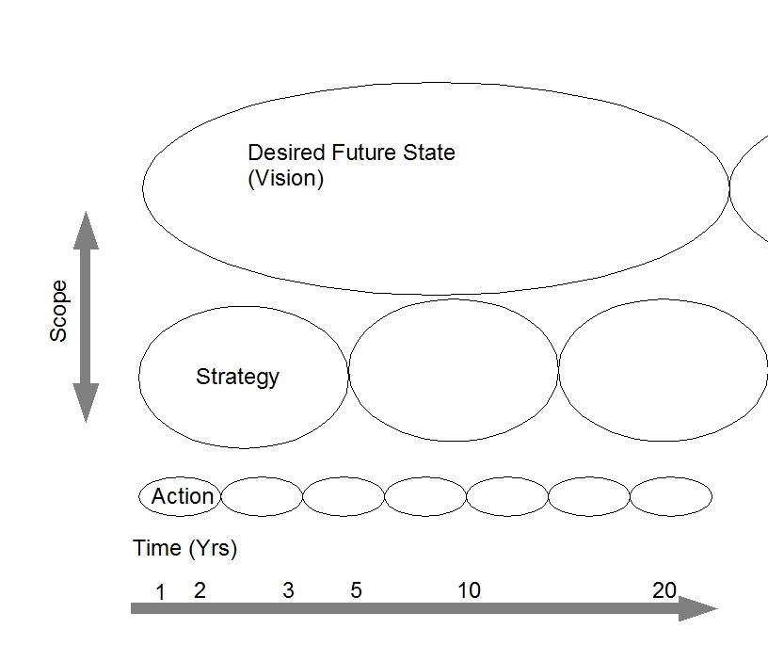
Approach: vision, strategy, action
Notes:
13

Slide 14
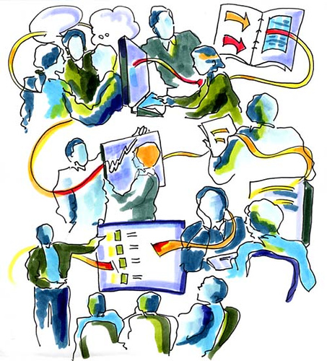
Engagement: World Café
7 Guiding Principles
Set the context
Create a hospitable space
Explore questions that matter
Encourage everyone’s contributions
Connect diverse perpectives
Listen together for insights
Share collective discoveries
Notes:
14
I

Slide 15
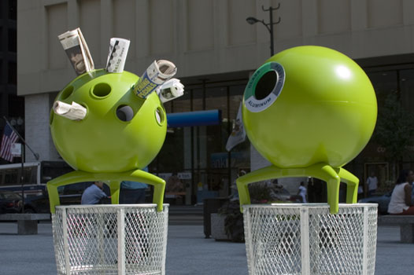
Innovation
15
Notes:
15
SSG worked as a consultant to another preeminent sustainability project in North America, Loreto Bay in Mexico. Loreto is the largest adobe construction site i the world, highlighting its dedication to the use of local materials. It is also restoring its watershed ecosystem, using native plants. SSG created a sustainable operations plan for Loreto, including dimensions ranging from human resoures, to agriculture, from management systems to purchasing frameworks. A second piece of work was to identify opportunities for demonstrating innovation in the area of sustainability. These garbage cans represent an innovative approach to waste management.

Slide 16
Trends: higher education
UC Irvine Opens Green Demonstration Dorm Room
U Guelph Students Hold 'Dream Green' Campaign
Social Marketing Program at U Toronto Aims to Cut Paper Use
'Sustainability is Sexy' Outreach Campaign at U Washington
U Florida Holds Carbon Neutral Football Game
Humber to Offer Sustainable Energy and Building Technology Program
Hocking College Breaks Ground for Energy Center
U Calgary Building Receives LEED Platinum
U Alberta Implements Green Cleaning Program
U British Columbia Chooses Building Renewal Over New Construction
Notes:
16
Major Trends
• Over the year, the number of schools with commitments to reduce their greenhouse gas emissions skyrocketed, from fewer than 20 to almost 500 institutions. • Green Building Diversification – Over 60 higher education green buildings were planned, started,
opened, or awarded LEED® certification in 2007.

Slide 17
Trends: best practices
Northern Arizona State University (Greening of the Curriculum)
Concordia University (Stakeholder engagement and assessment process)
University of British Columbia (Sustainability policy, strategies for implementation)
University of Arizona (Human rights & diversity, sustainable building)
University of Florida (Green procurement practices)
Harvard (13 LEED Buildings, 38 projects pending certification, green loan)
College of the Atlantic (Food services - grows all food on campus)
University of Portland (Local food focus, strong connection with local farms)
Notes:
17

Slide 18
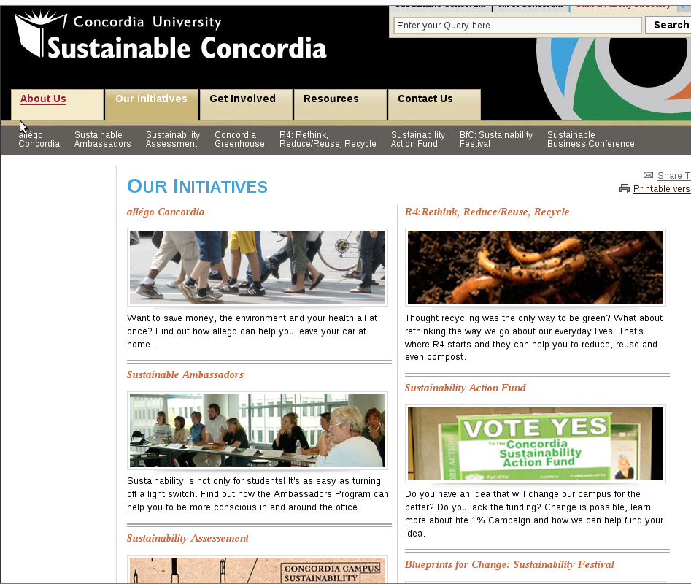
Trends: Sustainable Concordia
Highlights
R4 Program (rethink, reduce, reuse, recycle) includes monitoring, indoor and outdoor compost, dish rental, lug-a mug campaign.
Adopted an Environmental Policy
Most energy efficient university for ten years running
Annual sustainable business conference
New innovative green buildings
Conducted three sustainability assessments
Received support from Al Gore and David Suzuki
Notes:
SSG members have been working with Concordia University on its sustainability
initiatives since their inception, in a project that is nearly identical
to what Algonquin College has outlined. hired to coordinate
the first sustainability assessment using a multi-stakeholder process.
Concordia
University was the first educational institution to use the Campus Sustainability
Assessment Framework, still the most comprehensive report of its type completed in Canada to date. Melissa has presented on the results
of the work at Concordia around North America and most recently at
Plymouth University in the UK. Social, ecological and economic factors
are carefully integrated into the approach used with Concordia. Performance
of the university is measured in all three areas using distinct sets
of indicators.

Slide 19
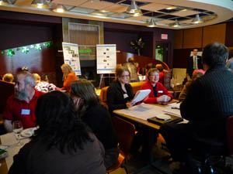
Trends: Algonquin
  World Cafés
  Sustainability Assessment
  Interactive website
  Algonquin Times
  Survey instruments
  Display board
  Community Radio CKDJ
  and internet radio
Notes:
19
Our experience indicates that the more we can engage all aspects of the campus community, the more successful the long-term effort will be. As a result our process includes a range of instruments that address different communication styles. In order to ensure the relevance and resonance of our communication efforts we hold focus groups at the outset of the process.
At the heart of the engagement strategy is an interactive website. You can post photos, stories, comments, even video to the website- it will be moderated by SSG. Additionally, all documents and studies produced will be placed on this website. Not only does it serve the college community, but other colleges and organisations seeking to undertake this process are able to use it as a resource.
The World Cafe engages people from diverse perspectives in dialog. This is a highly effective way of identifying strategic actions, as the creative energy is high when ideas and perspectives collide.
Interviews and articles are conducted with the local media so that the word is spread in this way.
Survey instruments are designed for specific audiences and deployed over the internet with appropriate prizes to encourage participation.

Slide 20
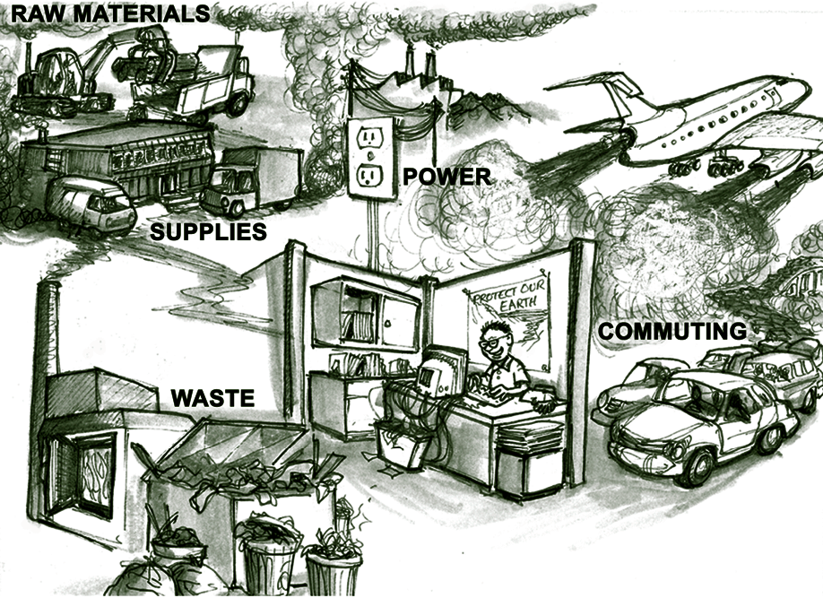
Case study: Mid-sized Non-profit organization
Goal: assess the annual energy usage and carbon emissions of a medium sized non-profit organization and plan for annual reductions.
Notes:
20

Slide 21
Example sources of emissions in Non- Profit Organizations
Transportation
Employee air and ground travel
Employee commuting
Building
Electricity
Air heating and cooling
Procurement
Office supplies
Paper use
Equipment purchase
Water heating

Slide 22

Establishing Baselines
Challenges:
Choosing baseline period
Scope
Accuracy
Variables
Notes:
22

Slide 23

Ownership of the process is crucial
Sustainability requires organizational transformation: board and senior management ownership of the process is essential
Notes:
23

Slide 24
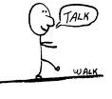
Implementation: Walking the Talk
Challenges:
Sustainability is not free
Feedback tools are essential
Compliance tools
Make it simple
Notes:
24

Slide 25
Learning from experience
Based on early experience, SSG developed a new program for energy audits and emissions tracking
Notes:
25

Slide 26
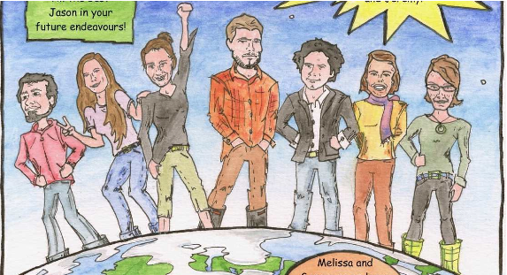
Who is SSG?
Cooperating toward transformative change:
SSG is an innovative Canadian workers cooperative that assists clients and collaborators to integrate social, ecological and economic practices throughout their organizations and work.
Notes:
26

Slide 27

What does SSG do for work?
  Green and sustainable building
  Organizational change
  Sustainable communities
  Energy and climate change
Notes:
27

Slide 28
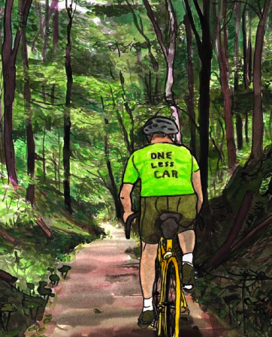
Our assessment
I: Toward co-operation, collaboration & community
  Ex. Percent of revenue dedicated to community support fund
II: Toward healthy workplace, healthy lives
  Ex. Total average absenteeism rate
III: Toward diversity, equity, justice
  Ex. Percent of worker members self-identifying as a minority
IV: Toward ecological sustainability
  Ex. Total kilometres traveled by worker members for SSG, by mode
Notes:
28

Slide 29
Our values
We want meaningful lives and work;
We want to make a difference;
We want to increase the sustainability of communities;
We believe we have a responsibility to do our very best;
We believe in fairness and respect to those present today and to future generations;
We believe that just doing is not enough;
We want to be at the leading edge of sustainable restorative building;
We want to be intellectually challenged and supported by colleagues;
We want to have a positive impact; to address root causes of societal problems.
Notes:
29

Slide 30
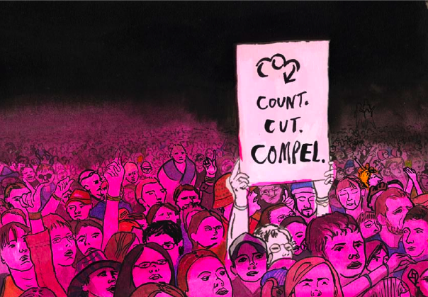
Count Cut Compel
Ditch you carbon emissions: www.countcutcompel.com
Notes:
30
Critical to this process is the tone and messaging.
we take considerable care in the way in which we frame our messsaging- for Algonquin College will began the process with focus groups to identify messagintgthat is appropriate and resonates throughout the process.

Slide 31
Questions?
Rebecca Foon
rebecca@sustainabilitysolutions.ca
Dale Hildebrand
dale@sustainabilitysolutions.ca
Notes:
31

